Slide 1
Daily Life in the Camps
By: Vaite Mahuru

Slide 2
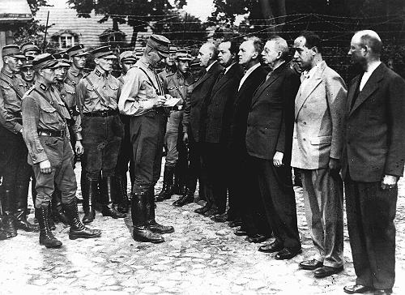
Concentration Camps
March 1933

Slide 5
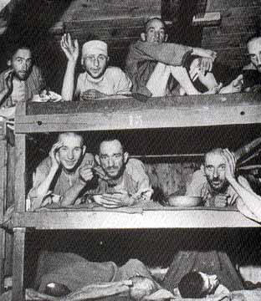
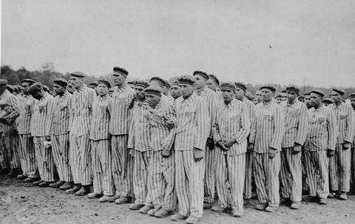
Pictures

Slide 6
References
http://www.ushmm.org
http://www.yadvashem.org/yv/en/holocaust/about/06/daily_life.asp

