Slide 1
Smooth endoplasmic reticulum
By: Vaite Mahuru & A.J. Tapa’atoutai
Period: A2

Slide 2
SER
lacks ribosomes and functions in lipid metabolism, carbohydrate metabolism, and detoxification
Synthesizes lipids, phospholipids, & steroids.
Found in variety of cell types.
Contains the enzymes-6-phosphatase.
Has tubules that are located near the cell periphery.

Slide 3
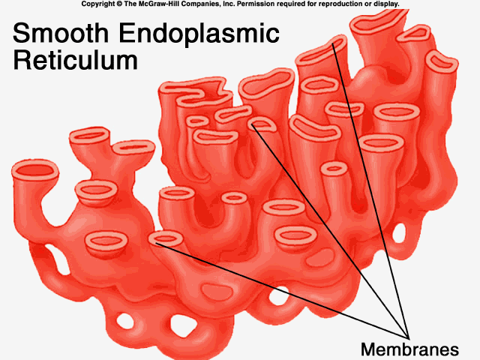
What does the SER do?
The SER does the Digestion & Detoxification of a Cell.
Packages proteins for transport.
synthesizes membrane phospholipids.
releases calcium.
Transform bile pigments
Breaks down glycogen.
stores ions in solution that the cell may need later

